Slide 1


MGMT 59000 AUD Craigslist Platform Improvement Project
Curious | Clusters
Cluster Centers -
Pulkit Batra
Esha Kaushal
Laura Rossi
Sachin Singhal
Abhinav Reddy Vangala
Notes:
Pulkit

Slide 2
Background
Curious | Clusters
Craigslist (stylized as craigslist) is an American classified advertisements website
The craigslist platform is advertiser oriented, providing a simple, low-structure interface where advertisers can create their ads with few constraints.
However, this low-structure creates additional work for potential buyers who have to parse through the content to find what they need.
Notes:
Pulkit

Slide 3
Business Analysis
Curious | Clusters
Current State
3 tier classification system :
Cons:
Irrelevant results
Inability to refine searches
Not at par with competitors
Location
Example: NYC
Category
Example: For sale
Subcategory
Examples: Clothing, Appliances, Electronics
Notes:
Pulkit

Slide 4
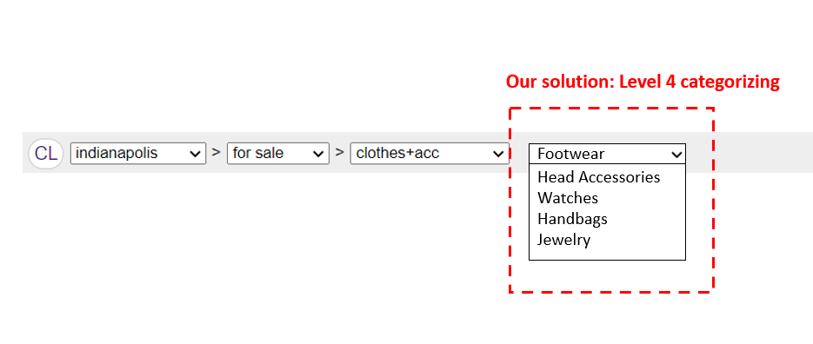
Business Analysis
Curious | Clusters
Our Solution
4th tier of categorization
Users can refine search results
No additional effort on behalf of advertisers
Categories are always relevant to advertised products
Notes:
Laura

Slide 5
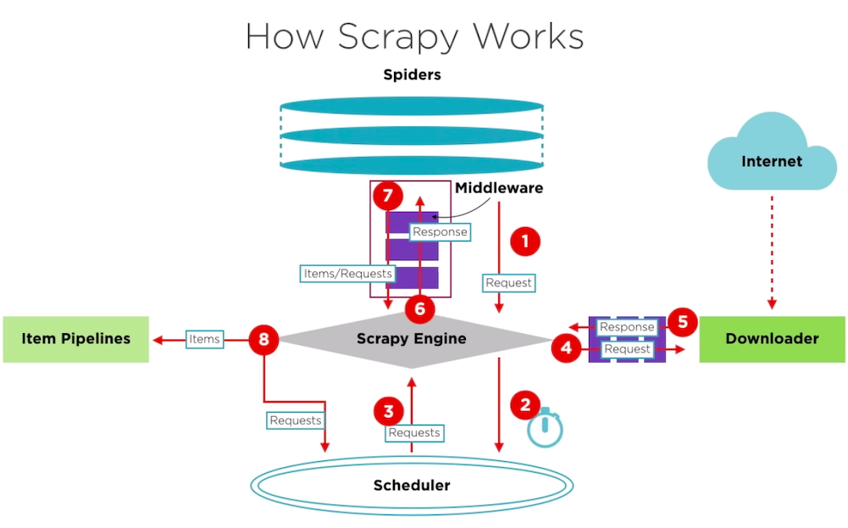
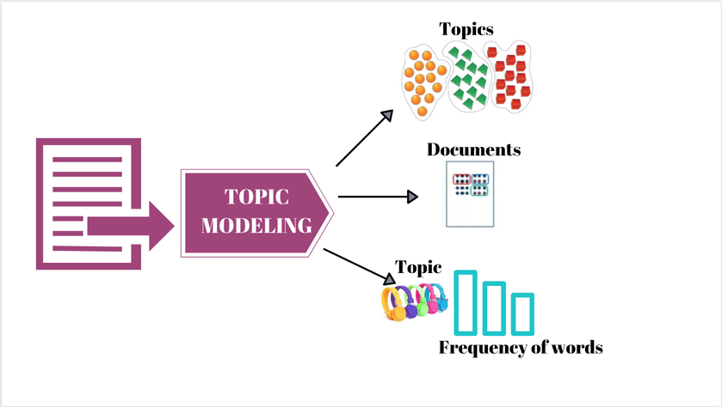

Data Analysis
Curious | Clusters
Data Acquisition
Data Cleaning
Topic Modeling
1
2
3
White space
Lemmatization
Punctuation
Capitalization
Vectorization
Notes:
Laura

Slide 6
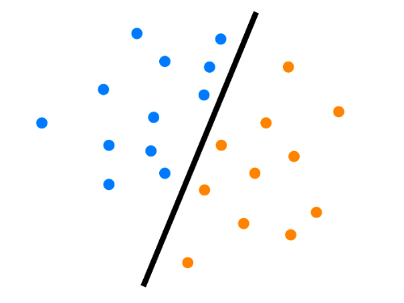
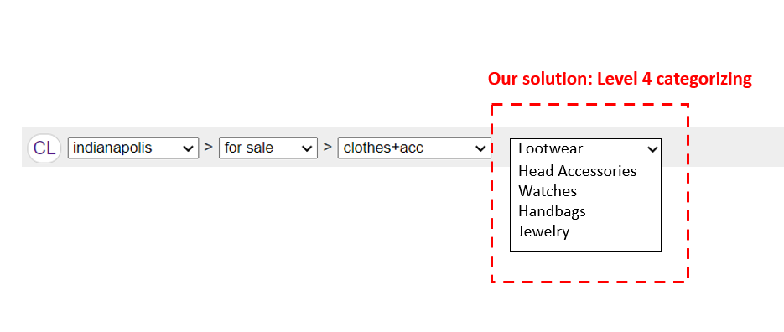
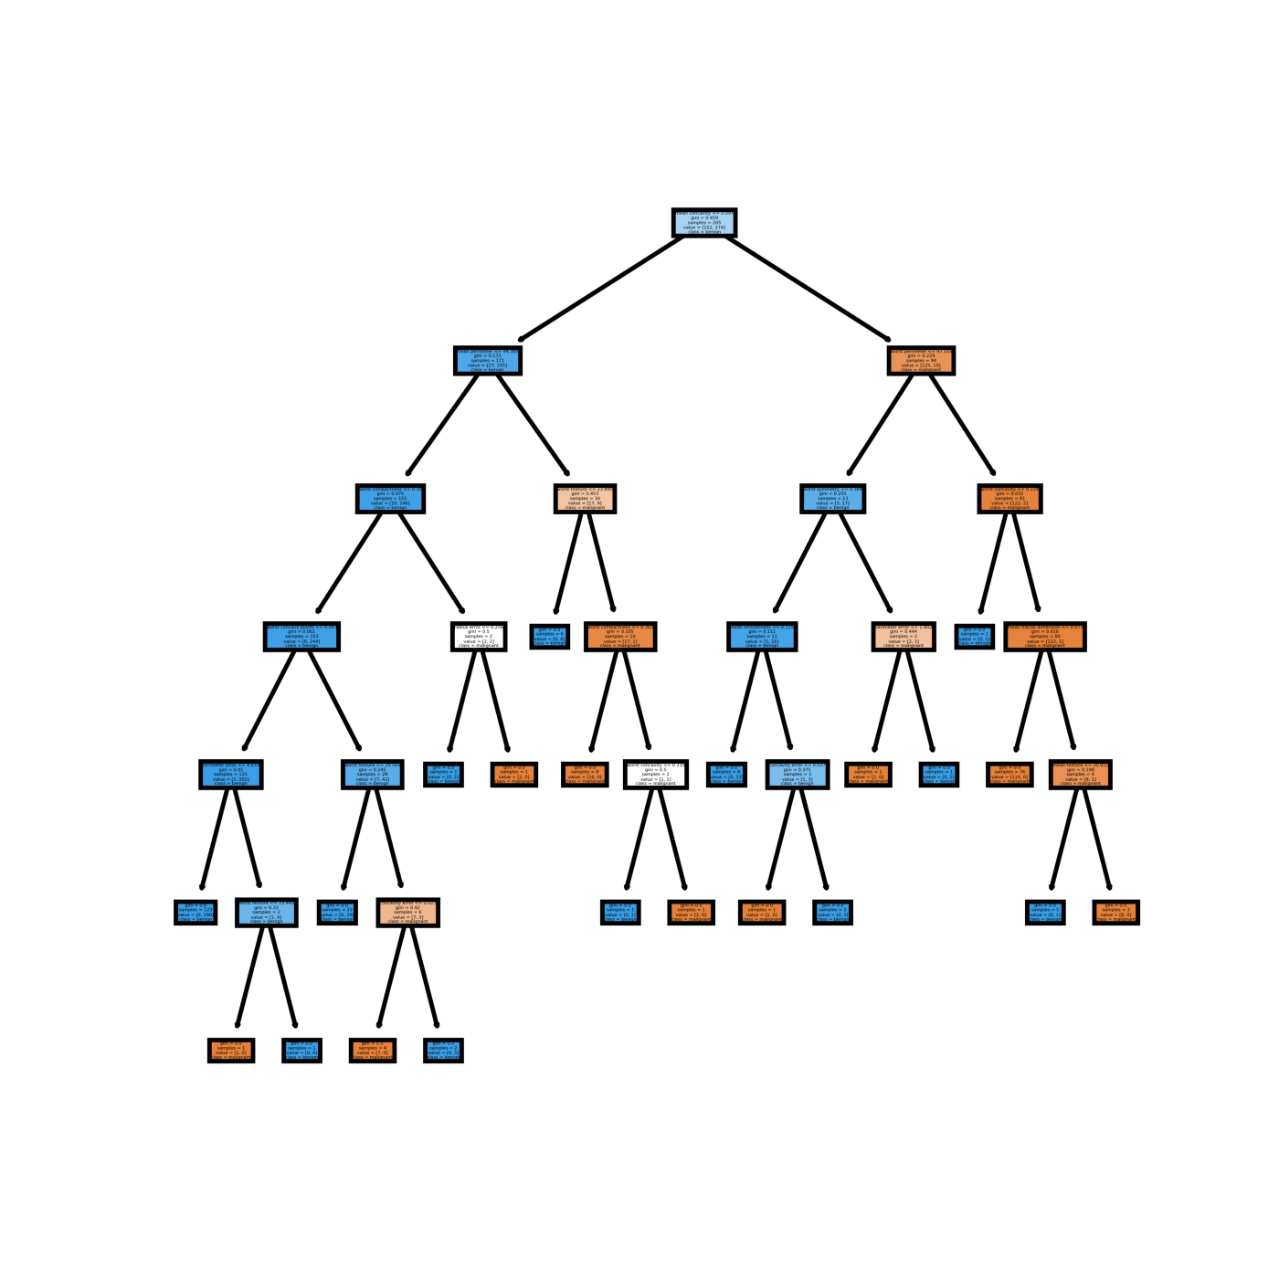
Data Analysis
Curious | Clusters
Topics to Categories
Classification
Implementation
4
5
6
T1
1
2
3
4
…
T2
1
2
3
4
…
T3
1
2
3
4
…
T4
1
2
3
4
…
T5
1
2
3
4
…
T6
1
2
3
4
…
Notes:
Laura

Slide 7
Classification Process
Curious | Clusters
Craigslist Ads title dataset
Final Labelled Dataset
S.No | Title
1 | Two Cutter & Buck menâ€™s shirts, size XL…..
2 | Men's Wool Suit Pin Stripes, 33 wai….
3 | Selling a pair of shoes that….
4 | 3 Menâ€™s size 15 1/2 short sleeve……
5 | Real snake Sandals…….
S.No | Title | Label
1 | Two Cutter & Buck menâ€™s shirts, size XL….. | Shirt
2 | Men's Wool Dress Suit Pin Stripes, 33 wai…. | Dress
3 | Selling a pair of shoes that…. | Footwear
4 | 3 Menâ€™s size 15 1/2 short sleeve…… | Dress
5 | Real snake Sandals……. | Footwear
Topics
Manual intervention to merge similar topics
LDA
Shirt
Suit
Sleeve
Shoe
Sandal
Dress
Footwear

Slide 8
Validation
Curious | Clusters
 | Furniture Classification | Appliances Classification | Clothing and Accessories classification
SVM | 98.48% | 99.62% | 99.9%
Logistic Regression | 96.88% | 98.60% | 99.04%
Decision Tree | 94.48% | 97.96% | 95.49%
Naïve Bayes | 79.17% | 90.57% | 87.52%
Random Forest | 66.69% | 81.53% | 80.33%
Naïve Bayes
Random Forest
SVM
Decision Tree
Logistic Regression

Slide 9

Value add for Business
Curious | Clusters
Single, one time topic selection.
No additional work required of advertisers
Simplify search for buyer
Improved User Experience
Notes:
Thankyou Sachin!
Now that we know what we did, lets see how it benefits Craiglists –
Our system effectively addresses the goal of automated 4th-tier classification. Categories are generated based on the currently available ads and assigned to new posts automatically, making it easier for buyers to find their desired product without impacting advertiser’s experience in generating an ad or requiring additional manual labor on behalf of Craigslist’s advertisers nor staff.
Based on user experience testing trends we observe that users generally give up because they realize they would have to manually locate the item. Our solution would enhance the user experience and user retention for craigslist

Slide 10

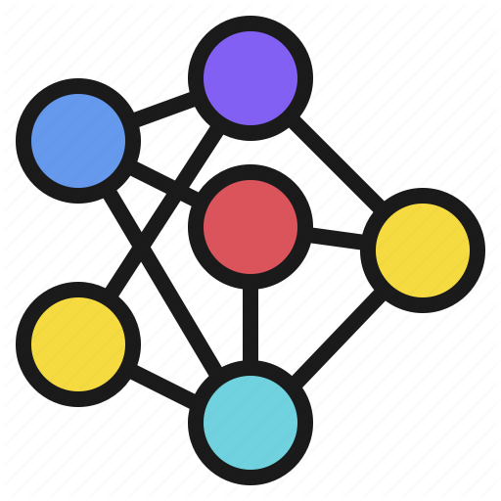



Conclusion
Curious | Clusters
Simple algorithm provides easy classification
Some manual intervention required in selecting best topics
Room to grow into more categories
Notes:
Overall, we saw how we accomplished our goal of adding a 4th layer using few simple classification algorithm.
We recognize that the task still requires some manual intervention for selecting the best topic but this would be a one time effort and the value add received is huge. More sophisticated models may be able to remove this manual requirement altogether, at the expense of computational power.
While we only demonstrate our models on three categories, the code provided should readily extent to other craigslist categories with similar performance. We recommend using a different LDA and categorization model for different categories, as similar words may have vastly different meanings in different categories. (For example, “Windows” may refer to the Operating System of a PC under “For Sale-Computers”, a service type under “Services – Automotive”, and yet a different kind of item or service under a third category).
Should craigslist receive positive feedback from providing additional levels of categorization, the same steps presented here to create 4-th level categories can be implemented to add 5th or higher levels categories as well.
With that we would like to conclude our presentation. Thankyou for listening & staying curious and we are open to any questions you may have.

Slide 11
Curious | Clusters
Thank you
Notes:
Esha

